Slide 1
Unsupervised representation learning with deep convolutional generative adversarial networks
yu - hsiang Cheng

Slide 2
Unsupervised representation learning with deep convolutional generative adversarial networks
Striving for simplicity :the all convolution net (ICLR 2015)
Network in network (ICLR 2014)
batch normalization(ICML 2015)
generative adversarial networks(nips 2014)
Wasserstein GAN(ICML 2017)
…..
Notes:
GAN == unsupervised && GAN
DEEP == batch normalization && skip connecting HE
CNN => CNN POOLING fully conncet
want remove pooling
want remove fullyconnect

Slide 3
keypoint
Tune model
GANs
filter for visualized(zfnet(deconv) ,guide backpro)
Dcgan arch
Notes:
Fine tune = exp
GAN =
Filter for visualized (zfnet deconv , guieded backpropa)
DCGAN

Slide 4
abstract
Hope to help bridge the gap between the success of CNNs for supervised learning and unsupervised learning
Clsass of CNNs call deep convolutional generative adversarial network (DCGAN)
Notes:
In recent year cnn base discriminator model and supervised learning is Breakthrough in computer vision
But unsupervised is less attention
In generative model (vae pixel cnn/rnn gan)
Hope to help bridge the gap between unsupervised and supervised learning
CNN base on GAN

Slide 5
INTRODUCTION
Learning reusable feature representations from large unlabeled datasets has been an area of active research.
We propose that one way to build good image representations is by training Generative Adversarial Networks (GANs)
Notes:
In unlabeled datasets how to learn reusable feature representation is active research
Propose a way can learn good image representation by training gan

Slide 6
Introduction
propose and evaluate a set of constraints on the architectural topology of Convolutional
GANs that make them stable to train in most settings ,name this (DCGAN)
We visualize the filters learnt by GANs and empirically show that specific filters have
learned to draw specific objects.
We show that the generators have interesting vector arithmetic properties allowing for easy manipulation of many semantic qualities of generated samples.
Notes:
Propose how to train convolution gan stable 1.remove pooling layer 2. remove fully connect layer 3. batch norm
Visualize filter show the GANs is “learn”
Show generators have interesting vector arithmetic allow for make qualities samples

Slide 7
Related work REPRESENTATION LEARNING FROM UNLABELED DATA
A classic approach to unsupervised representation learning is to do clustering on the data (for example using K-means), and leverage the clusters for improved classification scores
1. do hierarchical clustering of image patches (Coates & Ng, 2012) to learn powerful image representations
2. train auto-encoders (convolutionally, stacked (Vincent et al., 2010), separating the what and where components of the code (Zhao et al., 2015), ladder structures (Rasmus et al., 2015)) that encode an image into a compact code, and decode the code to reconstruct the image as accurately as possible
Deep belief networks (Lee et al., 2009) have also been shown to work well in learning hierarchical representations.
Notes:
Classic approach to unsupervised representation leanrning is to clustering (like use kmeans ) or kmean + RF
Train auto encoder that encode an image into a code
Dbn like multilayer but it’s training is different (layerwise) and use small dataset with label fine tune

Slide 8
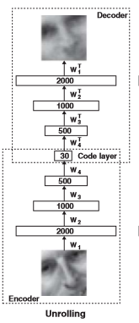
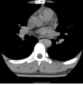
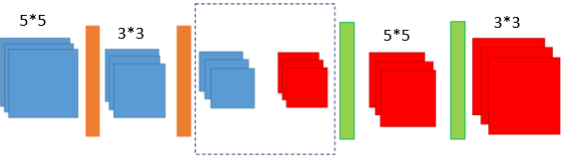

autoencoders
High-dimensional data can be converted to low-dimensional codes
by training a multilayer neural network with a small central layer
to reconstruct high-dimensional input vector
Try to learn $P_{model}$ (x) <=>$P_{data}$ (x)

Slide 9
Deep belief networks (pre-train)
RBM
(Same layer didn’t connect)
DBN
Layer wise pre training
(increase the variational lowerbound. )
Fine tuning(back propagation)
N->M->k , (N->M) (M->k->M)
If use gradient => local optimal ,want best (initialization is important)
After (Layer wise ) use gradient is better
If not use layer-wise pre-training (back propagation ,gradient )
Notes:
Layer wise training
Use small label dataset fine tune
No pre train out init weight is important
So pretrain and use gradient is better
If not use pretrain just use backpropagation , beacause net is deep your gradient ( decade for net )

Slide 10
pre training
Without pretraining, the very deep autoencoder always reconstructs the average of the training data, even after prolonged fine-tuning
Layer wise:
Pretraining helps generalization because it ensures that most of the information in the weights comes from modeling the images. The very limited information in the labels is used only to slightly adjust the weights found by pretraining
Notes:
Pretrian helps generalization => most of the information weight from modelling image

Slide 11
Fine tuning
it’s possible to keep some of the earlier layers fixed (due to overfitting concerns) and only fine-tune some higher-level portion of the network. This is motivated by the observation that the earlier features of a ConvNet contain more generic features that should be useful to many tasks, but later layers of the ConvNet becomes progressively more specific to the details of the classes contained in the original dataset.
Notes:
Fine tune benchmark dataset is millions data so its generalization is good
So we fixed earlier layer = > generic
Later layer us specific detail in the original dataset

Slide 12
When and how to fine-tune?
Size of new data set , similar to original dataset
New dataset small , similar to original dataset:
due to overfitting concerns, expect higher-level features in the ConvNet to be relevant to this dataset as well
New dataset large , similar to the original dataset:
more data ,more confidence that we won’t overfit
New dataset small ,very different from the original dataset:
it is likely best to only train a linear classifier
New dataset large ,very different from the original dataset:
1. can afford to train a ConvNet from scratch
2. often still beneficial to initialize with weights from a pretrained model
Notes:
Use cnn code as feature extraction train linear classification
Just tune it
Part of pre train layer and train classification
3.Use earlier layer generic ➔ pretrain (ALEX ) millions data generilzation good
4 Train convent from scratch

Slide 13
Related work Generating natural image
Non parametric models =>texture synthesis
Old problem in coputer graphics
Input some path od texture => (kNN) => generate a large pieces of the same texture
Problm? => more complex texture => copy patch directly tend not to work so well

Slide 14
Related work Generating natural image
However, generating natural images of the real world have had not much success until recently
VAE,GAN,pixelCNN/RNN

Slide 15
GAN
Generator network : try to fool the discriminator by generating real-looking image
Discriminator network : try to distinguish between real and fake image
Fake
/
Real
Random noise
Generator
discriminator
Data from real world

Slide 16
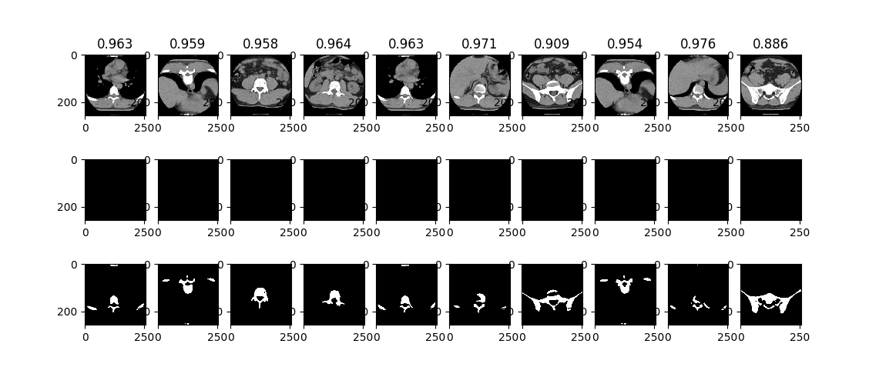
Why Gan
Discriminator easy defined loss function
But generative model hard to defined loss function
Ian goodfellow => use discriminator distinguish generative is good or not

Slide 17

Gan objective function
D wants to maximize objective such that D(x) is close to 1(real) and D(G(z)) is close to 0(fake)
G wants to minimize objective such that D(G(z)) is close to 1
Notes:
D distinguish image is real or fake D strong=> D(x) increase D(G(z)) decrease V(D,G) increase
G try D(G(z)) bigger V(D,G) smallleer

Slide 18
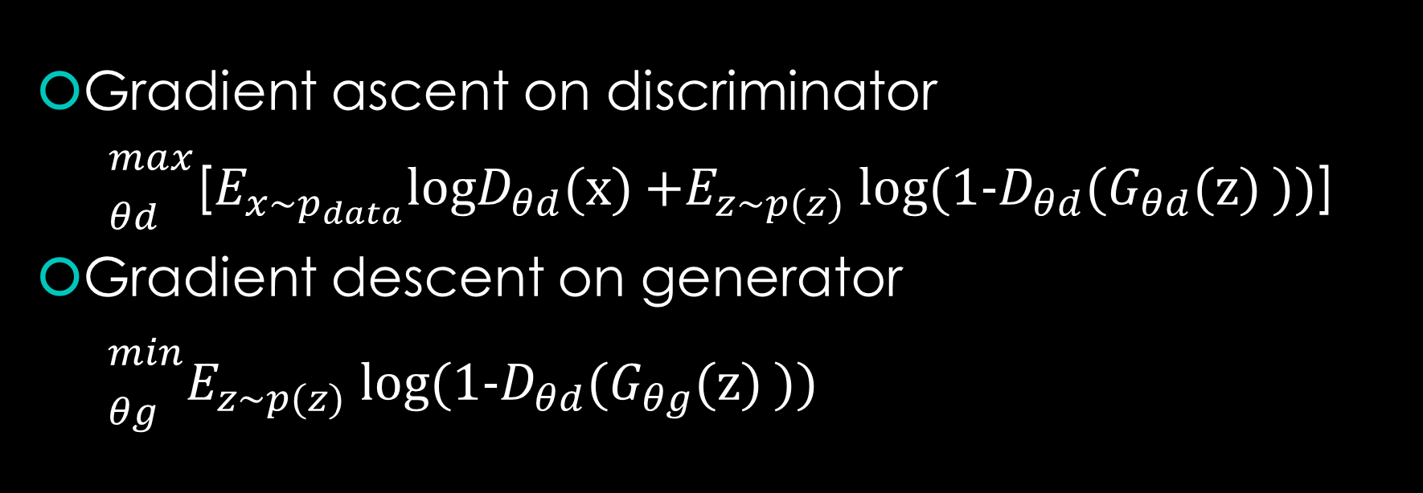
Gradient ascent on discriminator
${\begin{aligned} \\ \end{aligned}}_{θd}^{max}$[$E_{{x\sim p}_{data}}$log$D_{θd}$(x) +$E_{z\sim p(z)}$ log(1-$D_{θd}$($G_{θd}$(z) ))]
Gradient descent on generator
${\begin{aligned} \\ \end{aligned}}_{θg}^{min}E_{z\sim p(z)}$ log(1-$D_{θd}$($G_{θg}$(z) ))
Notes:
D

Slide 19


Gradient descent on generator
${\begin{aligned} \\ \end{aligned}}_{θg}^{min}E_{z\sim p(z)}$ log(1-$D_{θd}$($G_{θg}$(z) ))
Gradient descent on generator
${\begin{aligned} \\ \end{aligned}}_{θg}^{max}E_{z\sim p(z)}$ log($D_{θd}$($G_{θg}$(z) ))
Notes:
Check loss lanscape

Slide 20
GAN training
discriminator
Real Img
D_real
Discriminator loss:
Log(D_real) + Log(1-D_fake)
noise
Generator
K
discriminator
D_fake
Generator
Generator loss:
Log(D_fake)
noise

Slide 21
Related work VISUALIZING THE INTERNALS OF CNNS
One constant criticism of using neural networks has been that they are black-box methods, with little understanding of what the networks do in the form of a simple human-consumable algorithm.

Slide 22
VISUALIZING THE INTERNALS OF CNNS ZFNET
ImageNet 2013 winner , This architecture was more of a fine tuning to the previous AlexNet structure
Small filter size, and a very interesting way of visualizing feature maps (deconv).
AlexNet trained on 15 million images, while ZF Net trained on only 1.3 million images.

Slide 23
VISUALIZING THE INTERNALS OF CNNS ZFNET - mainpoints
First layer used filters of size 7x7(alexnet 11x11),and decrease stride value(zfnet :2 , alexnet:4)
Smaller filter size in first conv layer helps retain a lot of original pixel information in the input volume.
A filtering of size 11x11 proved to be skipping a lot of relevant information, especially as this is the first conv layer.
As the network grows, we also see a rise in the number of filters used.
Used ReLUs for their activation functions, cross-entropy loss for the error function, and trained using batch stochastic gradient descent.

Slide 24
VISUALIZING THE INTERNALS OF CNNS ZFNET - DeConvNet
Basic idea behind how this works is that at every layer of the trained CNN,
’deconvnet’ which has a path back to the image pixel
Forward path: an image is fed into CNN and activation are computed at each layer.

Slide 25
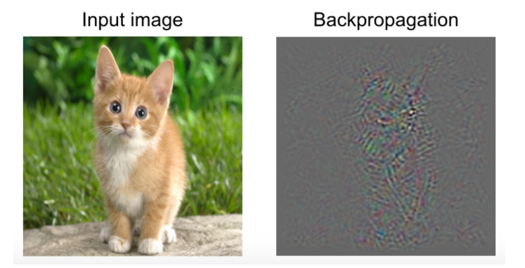
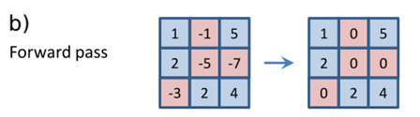
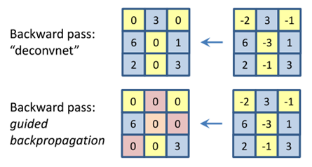
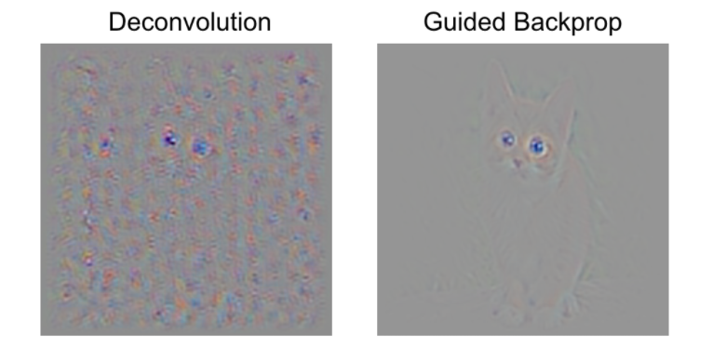
VISUALIZING THE INTERNALS OF CNNS guided backpropagation
Notes:
STRIVING FOR SIMPLICITY: THE ALL CONVOLUTIONAL NET guided backpropagation

Slide 26
Approach and model architecture
After extensive model exploaration we identified a family of architectures that result in stable training across a range of datasets and allowed for training higher resolution and deeper generative models
Adopting and modifying three recently demonstrated changes to CNN architecture
1, all convolution net
2, fully connect => global average pooling
3, batch normalization

Slide 27
Stride convolution
all convolutional net (Springenberg et al., 2014) which replaces deterministic spatial pooling functions (such as maxpooling) with strided convolutions, allowing the network to learn its own spatial downsampling. We use this approach in our generator, allowing it to learn its own spatial upsampling, and discriminator.

Slide 28
Pooling in CNN STRIVING FOR SIMPLICITY: THE ALL CONVOLUTIONAL NET ICLR-2015
The pooling layer can be seen as performing a feature-wise convolution
makes the representation in a CNN more invariant
the spatial dimensionality reduction performed by pooling makes covering larger parts of the input in higher layers possible
the feature-wise nature of the pooling operation (as opposed to a convolutional layer where features get mixed) could make optimization easier
Notes:
使CNN的表示不變性（invariant）
降維讓高層可以覆蓋輸入層更多部分
Feature wise optimization easier (offset weight)

Slide 29
network without abandoning the spatial dimensionality reduction
Assuming that only the third part – the dimensionality reduction performed by pooling –
is crucial for achieving good performance with CNNs
We can remove each pooling layer and increase the stride of the convolutional layer that preceded it accordingly.
It is equivalent to a pooling operation in which only the top-left feature response is considered and can result in less accurate recognition
We can replace the pooling layer by a normal convolution with stride larger than one

Slide 30
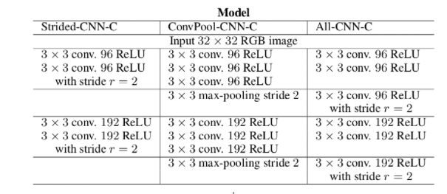
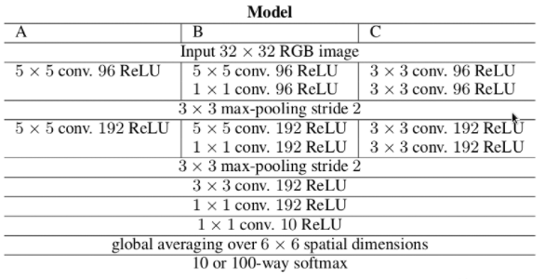
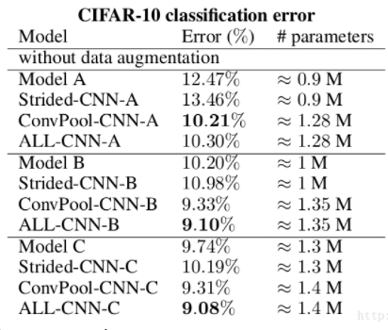
EXPERIMENTS
Notes:
Performance : C > B > A (filter size small)(prove zf net )
Arch : strided < model < convpool < cnn
Pooling不一定對每個網路有變好的效果 所以可以用 convolution with large stride replace

Slide 31
Global average pooling Network In Network ICLR 2014
mlpconv = conv + mlp(1x1 convolution), global average pooling
the fully connected layers are prone to overfitting (Hinton dropout),
It has improved the generalization ability and largely prevents overfitting(dropout)
Increased model stability but hurt convergence speed
Notes:
mlp can use backpro , mix cnn
Mlp feature reuse
1.更好的局部抽象；
2.更小的全局Overfitting；
3.更少的參數,no fcn

Slide 32
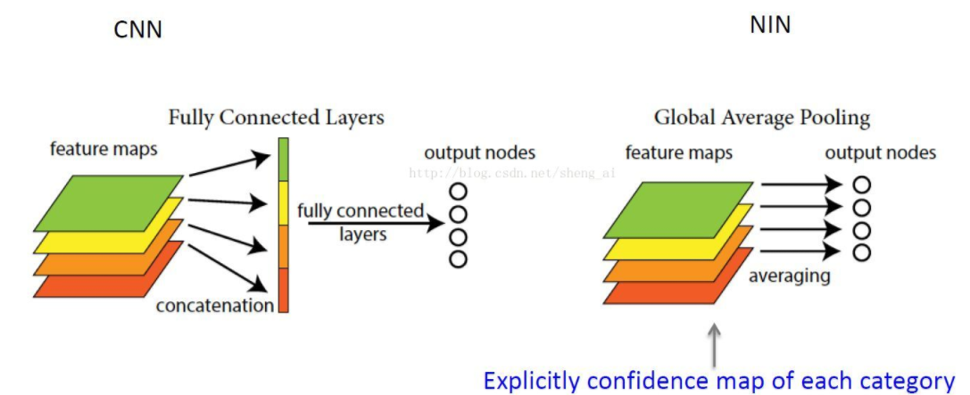
Global average pooling
One advantage of global average pooling over the fully connected layers is that it is more native to the convolution structure by enforcing correspondences between feature maps and categories. Thus the feature maps can be easily interpreted as categories confidence maps.
there is no parameter to optimize in the global average pooling thus overfitting is avoided at this layer. Futhermore, global average pooling sums out the spatial information, thus it is more robust to spatial translations of the input.
Notes:
1.強化feature map and categories 關係
2. 沒有很多參數(average) 避免overfitting ,
y=softmax(flatten(GAP(x)))
Softmax e^yi/sumj e^j

Slide 33
Global average pooling
model stability but hurt convergence speed. A middle ground of directly connecting the highest convolutional features to the input and output respectively of the generator and discriminator worked well.

Slide 34
Batch normalization
Normalizing the input to each unit to have zero mean and helps gradient flow in deeper model
Preventing the generator from collapsing all samples to a single point which is common failure mode observed in GANs
Resulted in sample oscillation and model instability. This was avoided by not applting batchnorm to the generator output layer and the discriminator input layer
Notes:
(solve weight init)
(help gradient )
防止generator把所有的樣本都收斂到同一個點。
BN 用到所有層 會導致樣本震盪和模型不穩定
每層輸入分布會隨著前一層參數更新而變化，對於優化非常深的網路有問題，分布變化會通過跨層傳播被放大 (0.1^40 1.1^40)

Slide 35
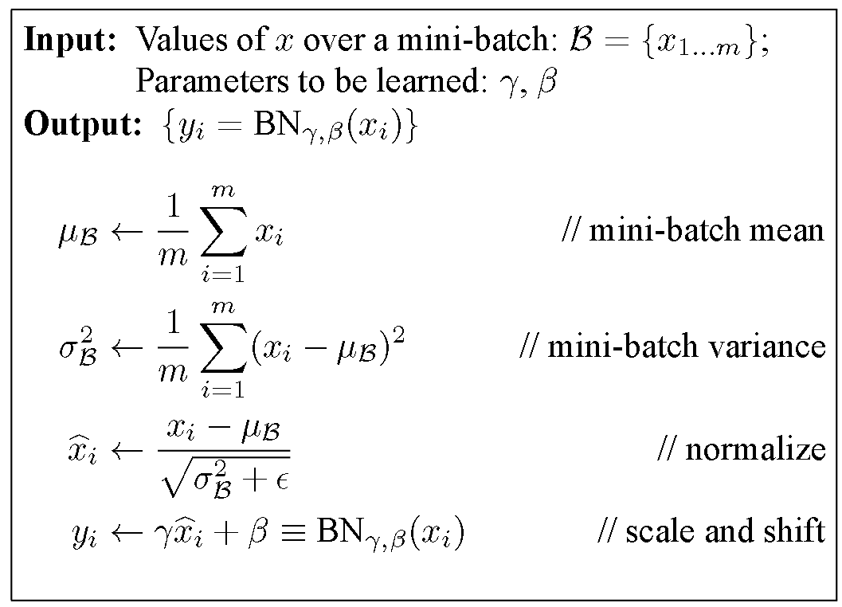
Batch normalization
xi = i * w + b
Beta = beta – learning rate * gradient
generalization
Activation function(ReLU /lReLu)

Slide 36
Relu, tanh, leaky Relu
Leaky Relu: activation in the discriminator for all layers(high resolution modeling)
Relu : is used in the generator with the exception of the output layer
Tanh :generator of the output layer (-1,1)
More quickly to saturate,symmetry
Notes:
隨機數累加 ~= normal distribution
Tanh 對稱性 [-1,1] sigmoid [0,1]

Slide 37
DCGAN Generator
No max pooling : increase spatial dimensionality through fractionally-strided convolution
Batch normalization: normalize responses to have zero mean and unit variance over the entire mini-batch,but not in last layer
Notes:
(to prevent sample oscilation and model instability)

Slide 38
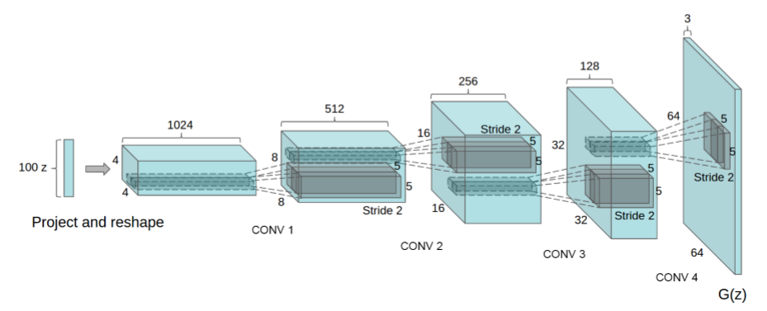
Model architecture

Slide 39
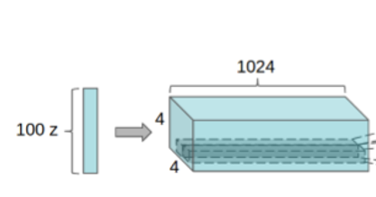
Model architecture
Uniform noise distribution
z
(1,100)
4x4x1024
w
w
w
w
w
w
w
w
w
w
w
……………….....
w
w
w
w
w
(100,1)
(1,4x4x1024)
?
relu
batchnorm
reshape
(4x4,1024)
Start convolution stack

Slide 40
Model architecture

Slide 41
Upsample (unpooling)
1
1
2
2
1
2
1
1
2
2
Nearest neighbor
3
4
3
3
4
4
3
3
4
4
1
0
2
0
1
2
0
0
0
0
“bed of nails”
3
4
3
0
4
0
0
0
0
0

Slide 42
maxunpooling
4
1
5
9
0
0
0
2
5
3
8
7
5
9
1
2
1
0
0
0
…….
3
5
8
6
9
8
3
4
0
0
4
0
6
9
7
4
0
3
0
0
Max
pooling
…….

Slide 43
Deconvolution(transpose matrix)
A=(3,3) => A.reshape(1,9)
B=(9,4)
C= A * B = (1,4)
C*B_transpose = (1,4)(4,9) = (1,9)

Slide 44
fractionally strided 1d
a
b
x
y
z
ax
ay
Azbx
by
bz

Slide 45
fractionally strided convolutions(deconv)
ht of as the gradient of some convolution with respect to its input
1
1
2
1
2
1
1
3
Stride = 1,1
1
2
4
1
10
3
2
3
4
1
1
6
3
3
7
4
1
1
2
2
1
2
1
1
Stride = 2,2
1
1
2
2
3
4
1
1
3
3
4
4
3
3
4
4
Notes:
Avg or sum

Slide 46
fractionally strided convolutions
0
0
0
0
1
3
2
0
1
2
0
1
1
Stride = 1,1
4
10
6
0
3
4
0
1
1
3
7
4
0
0
0
0

Slide 47
fractionally strided convolutions
0
0
0
0
0
1
1
2
2
0
1
0
2
0
1
1
Stride = 2,2
1
1
2
2
0
0
0
0
0
1
1
3
3
4
4
0
3
0
4
0
3
3
4
4
0
0
0
0
0

Slide 48
fractionally strided convolutions
(4x4,1024)
1x1,1024
1024x5x5x512
1024
w
+
w
+
w
+
w
+
w
+
w
+
512
w
w
w
w
w
relu
batchnorm
5x5
w
w
w
w
w
w
w
w
w
w
w
w
w
w
w
w
w
w
w
w
Stride=2
Notes:
? Net in net or simple

Slide 49
DCGAN Generator
Relu
batchnorm
tanh

Slide 50
DCGAN Discriminator
64x64x3
1
Real img
32x32x64
4x4x512
16x16x128
8x8x256
0
Average pooling
Gen
img
w
w
w
w
w
…..
w
w
512
sigmoid
0~1
Notes:
Softmax = e^yi /sumj E^j

Slide 51
Detail of adversarial training
DataSet : LSUN, image1k, Faces dataset
No preprocessing just scaling to the range of tanh activation function[ -1,1 ]
Batch size = 128
All weights were initialized from a zero centered normal distribution with standard deviation 0.02
LeakyReLU slope of the leak set 0.2
Learning rate = 0.0002
Notes:
Weight ( 0~ 0.02)

Slide 52
Trick in DCGAN
Normalize the inputs
Normalize img [-1,1]
Tanh as the last layer of generator output
Modified loss function
In paper G =>min log(1-D)
G => max log(D)

Slide 53
Trick in DCGAN
Flip label when training generator
Real = fake
Fake = real
Use spherical z : not uniform use gussian
Batch norm : use instance norm (batch = 1/HWT, instance = 1/HW)
Avoid sparse gradient : ReLU, maxpooling
Use Adam (G = Adam, D= SGD)
Soft and noisy label : real label fake
D quickly 0 is collapse
If you have label use them

Slide 54
LSUN (LARGE-SCALE SCENE UNDERSTANDING)
LSUN
bedrooms :3million training example
No augmentation
Notes:
視覺質量提高，也增加了對訓練樣本overfitting和momorization的擔心。
我們展示出了訓練一個週期的樣本表明，我們的模型不是簡單的通過過擬合和記憶訓練樣本，來產出高質量的樣本

Slide 55
Deduplication
To further decrease the likelihood of the generator memorizing input examples
We fit a 3072-128-3072 de-noising dropout regularized RELU autoencoder on 32x32 downsampled center-crops of training examples.
The resulting code layer activations are then binarized via thresholding the ReLU activation which has been shown to be an effective information preserving technique

Slide 56
FACES
Dataset : 3M image from 10K people
Run OpenCV face detector on these images ,keeping the detections that are sufficiently high resolution , (350000 face boxes) <= training

Slide 57
Imagenet 1K
32x32 center crop , no data augmentation

Slide 58
EMPIRICAL VALIDATION of DCGAN capabilities
One common technique for evaluating the quality of unsupervised representation learning algorithms is to apply them as a feature extractor on supervised datasets and evaluate the performance of linear models fitted on top of these features.

Slide 59
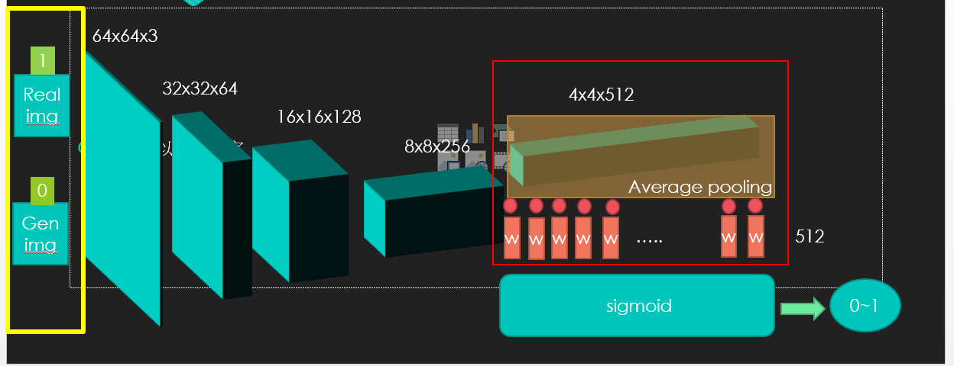
Gan AS FEATURE EXTRACTOR
Train on ImageNet1k test cifar10
use the discriminator’s convolution feature from all layer
Maxpooling each layers representation to produce a 4x4 spatial grid
Flatten and concatenated to form a 28762 dimensional ? vector
Train linear L2-SVM for CIFAR-10

Slide 60
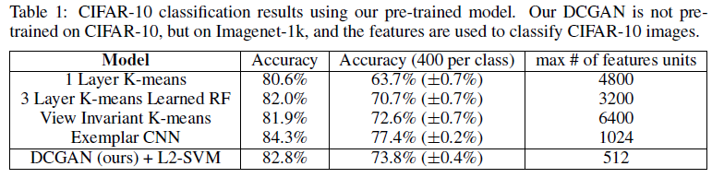
EMPIRICAL VALIDATION of DCGAN capabilities
STL10
Imagenet 1K
1792
Notes:
Max # of features units
Not fair for 1 layer 3 layer

Slide 61
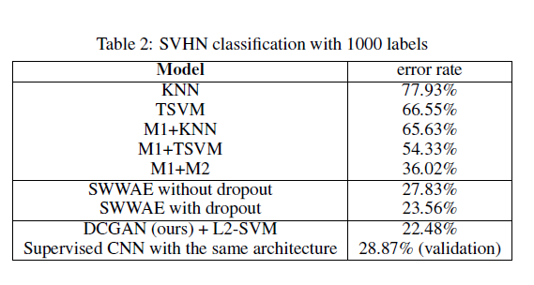
Classifying SVHN DIGITS using GANs as feature extractor
DCGAN for supervised purpose when labeled data is scarce
Split off a validation set of 10000 example for hyperparameter and select model
CNN architecture used in DCGAN is not the key contributing factor of the model’s performance by training a purely supervised CNN with the same architecture on the same data and optimizing this model via random search over 64 hyperparameter trials

Slide 62
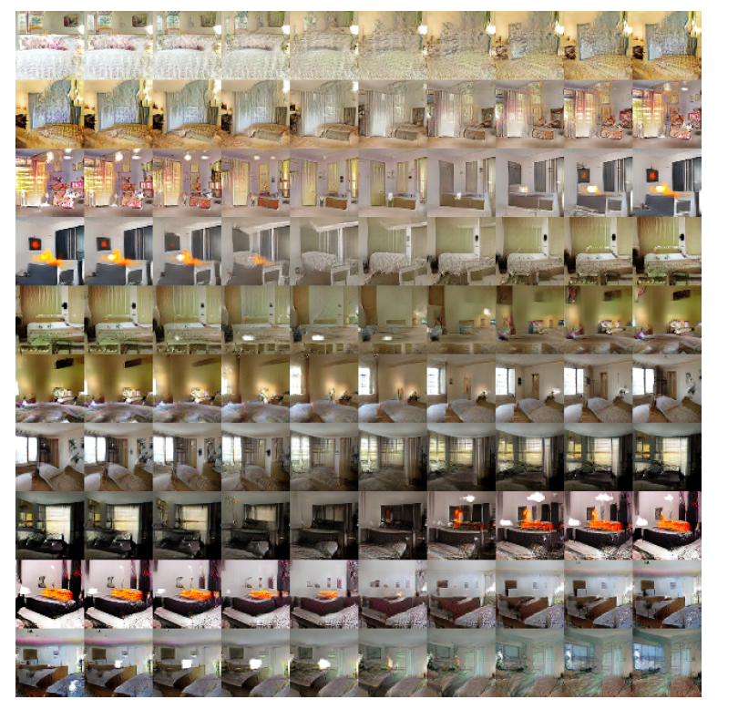
WALKING IN THE LATENT SPACE
we can reason
that the model has
learned relevant and
interesting representations.
Notes:
沒有窗戶到有窗戶
電視到窗戶

Slide 63
visual the discriminator features
supervised training of CNNs on large image datasets results in very powerful learned features
an unsupervised DCGAN trained on a large image dataset can also learn a hierarchy of features
Use guided backpropagation

Slide 64
VISUALIZING THE DISCRIMINATOR FEATURES
show in Fig.5 that the features learnt by the discriminator activate on typical parts of a bedroom, like beds and windows.For comparison, in the same figure, we give a baseline for randomly initialized features that are not activated on anything that is semantically relevant or interesting.

Slide 65
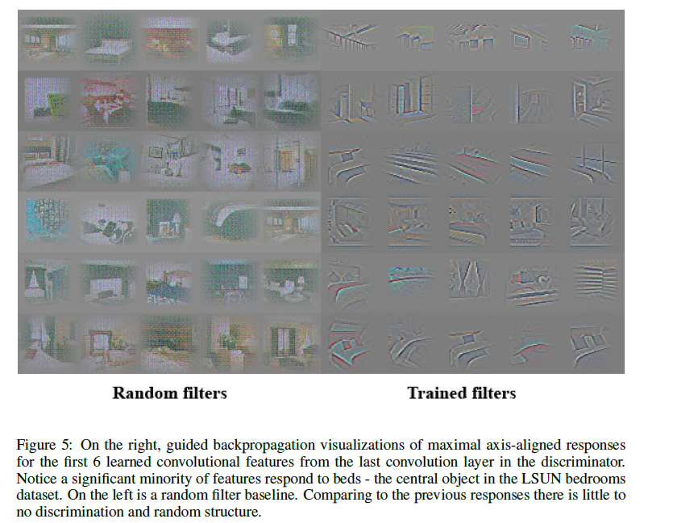

Slide 66
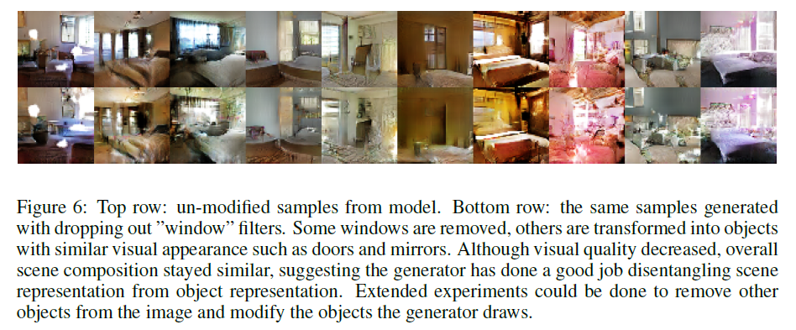
Notes:
1.輸入有窗的圖片給G
然後去除響應值高的過濾器，發現G會用電視啊牆啊來替代窗。

Slide 67
VECTOR ARITHMETIC ON FACE SAMPLES
vector(”King”) - vector(”Man”) + vector(”Woman”) resulted in a vector whose nearest neighbor was the vector for Queen
We investigated whether similar structure emerges in the Z representation of our generators.
Experiments working on only single samples per concept were unstable, but averaging the Z vector for three examplars showed consistent and stable generations that semantically obeyed the arithmetic

Slide 68
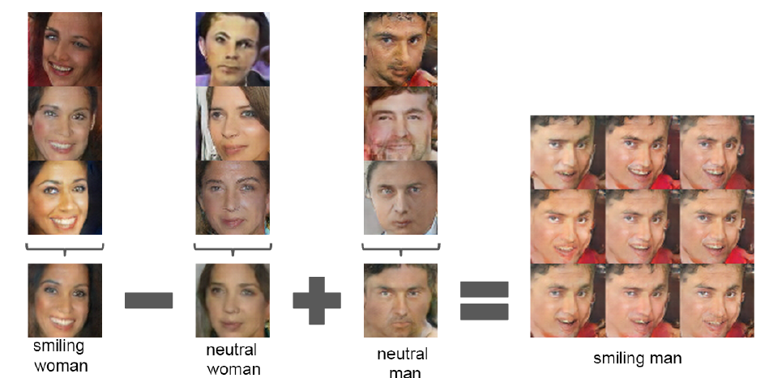
uniform noise sampled
with scale +-0.25 was
added to Y to produce
the 8 other samples

Slide 69
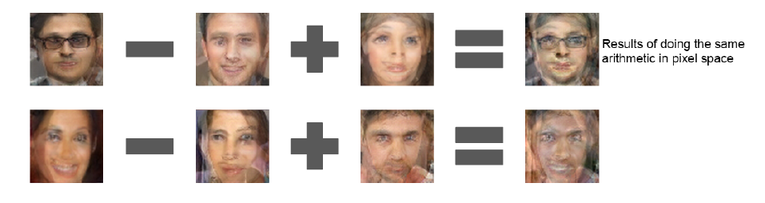

Slide 70
Conclusion and future work
Propose a more stable set of architecture for training generative adversarial networks
Evidence that adversarial networks learn good representations of images for supervised learning and generative modeling
Extending this framework to other domains such as video and audio

Slide 71
Supplementary material
Conditional version of our model , evaluating the conditional distributions learned
Found removing the scale and bias parameters from batchnorm produced better result for both model
We speculate that the noise introduced by batchnorm helps the generative model to better explore and from the underlying data distribution

